Slide 1
Big Data Analytics in the Travel & Transportation Industry
Capstone Project
By
SHIVANAGARAJU KARNAKANTI
24MBMA70
School of management studies
Notes:
Introduce the project, its goals, and state that visuals are representative and can be regenerated with the real dataset if uploaded.

Slide 2
Agenda
• Project Overview
• Methodology & Tech Stack
• Key Visuals (Demand, Pricing, Utilization)
• Customer Segmentation
• Conclusions & Next Steps
Notes:
Walk through the agenda briefly.

Slide 3
Dataset & ETL Pipeline
• Columns used: timestamp, pickup, drop, fare, surge, driver_id, customer_id, distance, payment_type
• Platform: Databricks + PySpark for scalable ETL and feature engineering
• Outputs: Time-series forecasts, pricing optimization signals, utilization metrics, segments
Notes:
Explain source data, key columns, and pipeline steps.

Slide 4
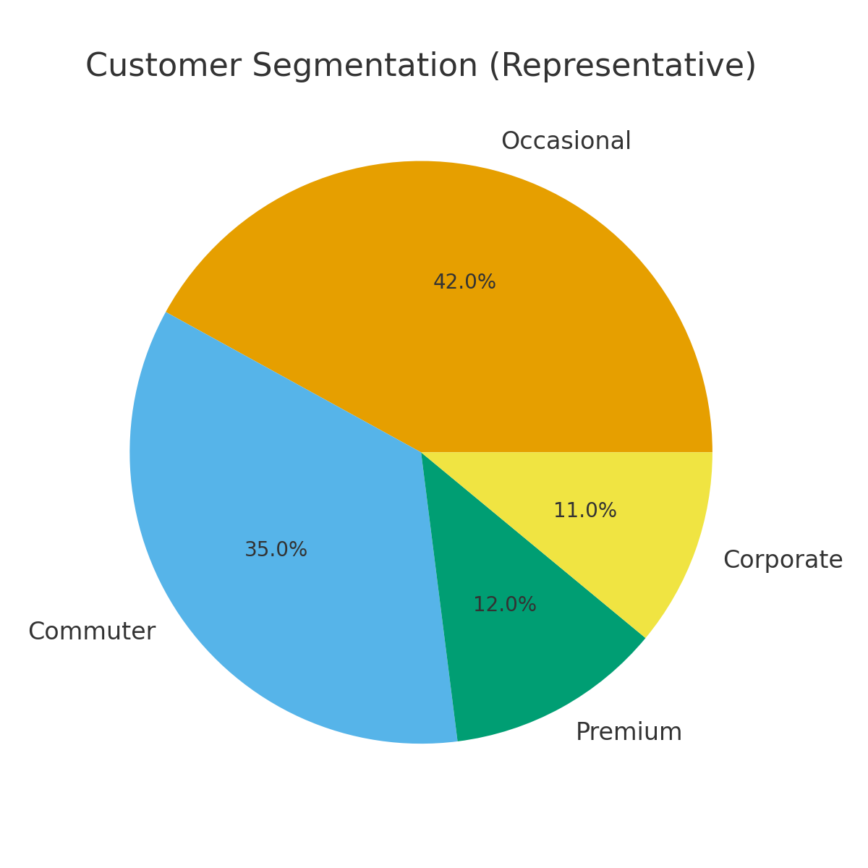
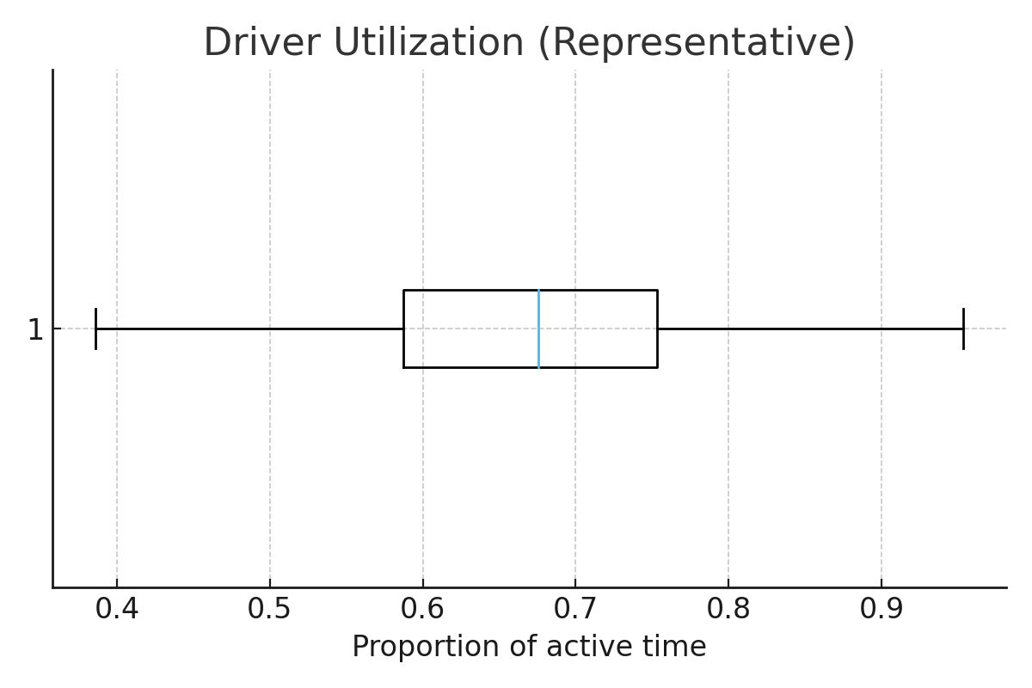
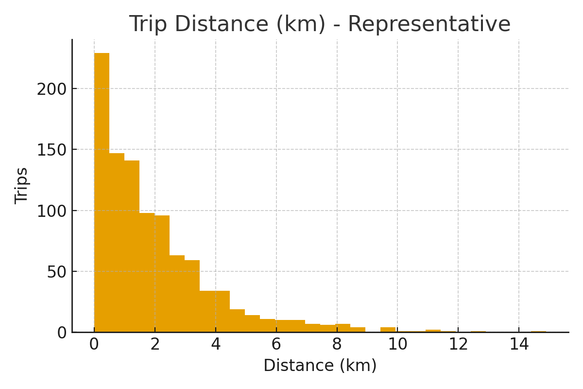
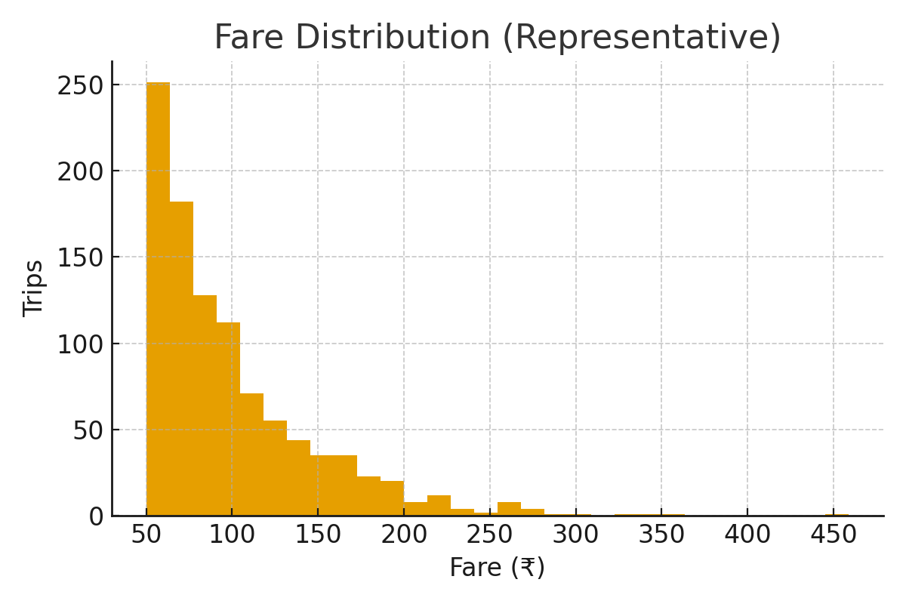
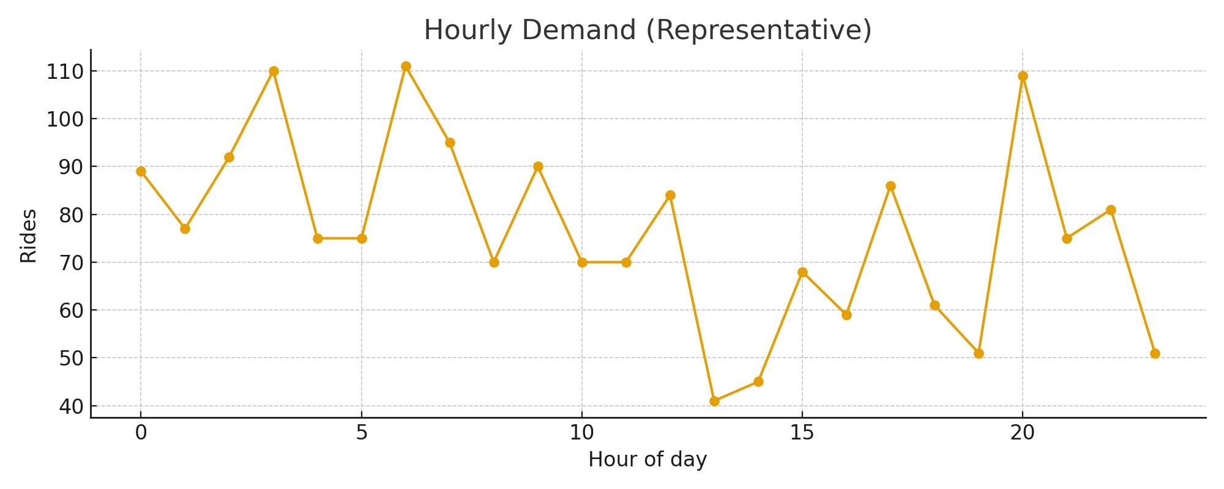
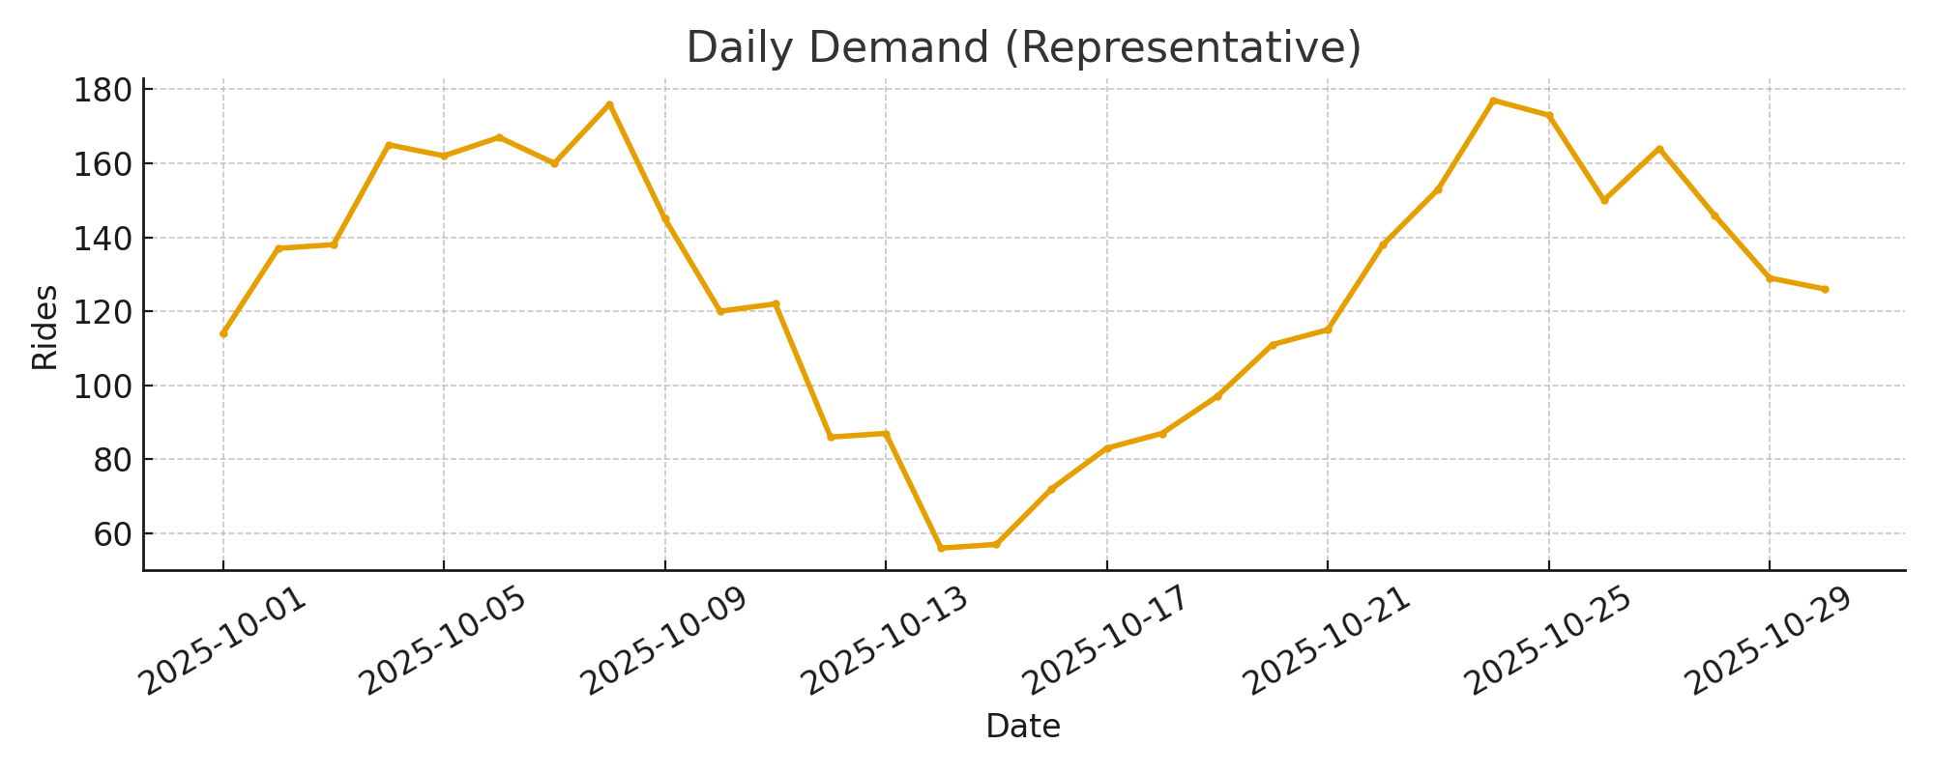
RESULTS
Notes:
Discuss peaks (e.g., morning/evening) and implications for driver allocation and surge pricing.

Slide 5
Recommendations & Future Scope
• Deploy real-time forecasting pipeline in Databricks (streaming + model serving)
• Implement dynamic pricing using demand signals + fairness constraints
• Integrate weather & events data for improved forecast accuracy
• Driver incentives & shift optimization to reduce idle time
Notes:
Cover practical next steps and measurable KPIs (reduction in wait times, increase in matches, revenue uplift).

Slide 6
Thank You
Notes:
Wrap up and offer to regenerate with your dataset.

